Slide 1
Search: the beginning
Nisheeth

Slide 2
Interdisciplinary area
Information retrieval
NLP
Search
Machine learning
Human factors

Slide 3
Outline
Components
Crawling
Processing
Indexing
Retrieval
Evaluation
Research areas
Text processing
Beyond bag-of-words representations
Retrieval algorithms
Context sensitivity
Personalization
Diversity and serendipity
Evaluation methods
Usability studies
Real-time tracking

Slide 4
Emphasis areas
Text processing
Basic algorithms
Criteria for model selection
Data transformations
Retrieval
Algorithms
Ranking schemes
Research foci
Evaluation
Existing methods
Problems
Research foci

Slide 5
De-emphasized areas
Search engine architecture
Crawling
Indexing
Scalability concerns
Privacy concerns

Slide 6
Resources
Croft, Metzler & Strohman (ex-Google)
Search Engines: Information Retrieval in Practice (pdf on HCC webpage)
Chapters 1,2,4,6,7,8
Other research papers and books as we go along

Slide 7
Boolean search
The simplest possible search model

Slide 8
The classic search model
Person
Need
Query
Search
engine
Query refinement
Results
Collection

Slide 9
Boolean search
Search queries always Boolean formulae
Later deal with natural language queries
No uncertainty about corpus membership
Later deal with document clusters
Search intent is known
Later deal with context, personalization
Great example – Gmail search
Reading material
Manning, Raghavan & Schutze, Intro to IR
Chapter 1
Available online

Slide 10
Boolean retrieval: Exact match
Sec. 1.3
The Boolean retrieval model is being able to ask a query that is a Boolean expression:
Boolean Queries are queries using AND, OR and NOT to join query terms
Views each document as a set of words
Is precise: document matches condition or not.
Perhaps the simplest model to build an IR system on
Primary commercial retrieval tool for 3 decades.
Many search systems you still use are Boolean:
Email, library catalog, Mac OS X Spotlight

Slide 11
Example document corpus
Sec. 1.1
Which plays of Shakespeare contain the words Brutus AND Caesar but NOT Calpurnia?
One could grep all of Shakespeare’s plays for Brutus and Caesar, then strip out lines containing Calpurnia?
Why is that not the answer?
Slow (for large corpora)
NOT Calpurnia is non-trivial
Other operations (e.g., find the word Romans near countrymen) not feasible
Ranked retrieval (best documents to return)
Later lectures
Notes:
Grep is line-oriented; IR is document oriented.

Slide 12
Term-document incidence matrices
Sec. 1.1
1 if play contains word, 0 otherwise
Brutus AND Caesar BUT NOT Calpurnia

Slide 13
Incidence vectors
Sec. 1.1
So we have a 0/1 vector for each term.
To answer query: take the vectors for Brutus, Caesar and Calpurnia (complemented) ➔ bitwise AND.
110100 AND
110111 AND
101111 =
100100

Slide 14
Answers to query
Sec. 1.1
Antony and Cleopatra, Act III, Scene ii
Agrippa [Aside to DOMITIUS ENOBARBUS]: Why, Enobarbus,
When Antony found Julius Caesar dead,
He cried almost to roaring; and he wept
When at Philippi he found Brutus slain.
Hamlet, Act III, Scene ii
Lord Polonius: I did enact Julius Caesar I was killed i’ the
Capitol; Brutus killed me.
Notes:
Wikimedia commons picture of Shake

Slide 15
Bigger collections
Sec. 1.1
Consider N = 1 million documents, each with about 1000 words.
Avg 6 bytes/word including spaces/punctuation
6GB of data in the documents.
Say there are M = 500K distinct terms among these.

Slide 16
Can’t build the matrix
Sec. 1.1
500K x 1M matrix has half-a-trillion 0’s and 1’s.
But it has no more than one billion 1’s.
matrix is extremely sparse.
What’s a better representation?
We only record the 1 positions.
Why?

Slide 17
Inverted index
Sec. 1.2
For each term t, we must store a list of all documents that contain t.
Identify each doc by a docID, a document serial number
Can we used fixed-size arrays for this?
Brutus
1
2
4
11
31
45
173
174
Caesar
1
2
4
5
6
16
57
132
Calpurnia
2
31
54
101
What happens if the word Caesar is added to document 14?

Slide 18
Inverted index
Sec. 1.2
We need variable-size postings lists
On disk, a continuous run of postings is normal and best
In memory, can use linked lists or variable length arrays
Some tradeoffs in size/ease of insertion
Posting
Brutus
1
2
4
11
31
45
173
174
Caesar
1
2
4
5
6
16
57
132
Calpurnia
2
31
54
101
Dictionary
Postings
Sorted by docID (more later on why).
Notes:
Linked lists generally preferred to arrays
Dynamic space allocation
Insertion of terms into documents easy
Space overhead of pointers

Slide 19

Inverted index construction
Sec. 1.2
Documents to
be indexed
Friends, Romans, countrymen.
Tokenizer
Token stream
Friends
Romans
Countrymen
Linguistic modules
Modified tokens
friend
roman
countryman
Indexer
friend
2
4
roman
1
2
Inverted index
countryman
13
16
Notes:
Document icons from free icon set: http://www.icojoy.com/articles/44/

Slide 20
Initial stages of text processing
Tokenization
Cut character sequence into word tokens
Deal with “John’s”, a state-of-the-art solution
Normalization
Map text and query term to same form
You want U.S.A. and USA to match
Stemming
We may wish different forms of a root to match
authorize, authorization
Stop words
We may omit very common words (or not)
the, a, to, of

Slide 21
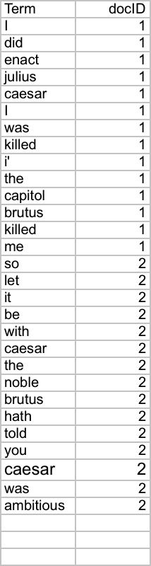
Indexer steps: Token sequence
Sec. 1.2
Sequence of (Modified token, Document ID) pairs.
Doc 1
Doc 2
I did enact Julius
Caesar I was killed
i’ the Capitol;
Brutus killed me.
So let it be with
Caesar. The noble
Brutus hath told you
Caesar was ambitious

Slide 22
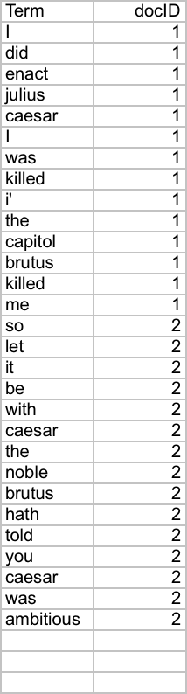
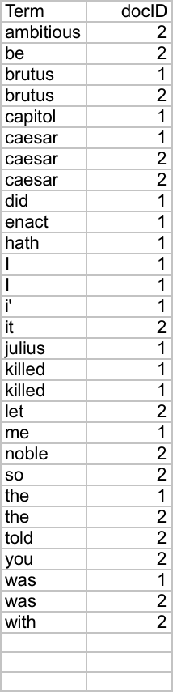
Indexer steps: Sort
Sec. 1.2
Sort by terms
And then docID
Core indexing step

Slide 23
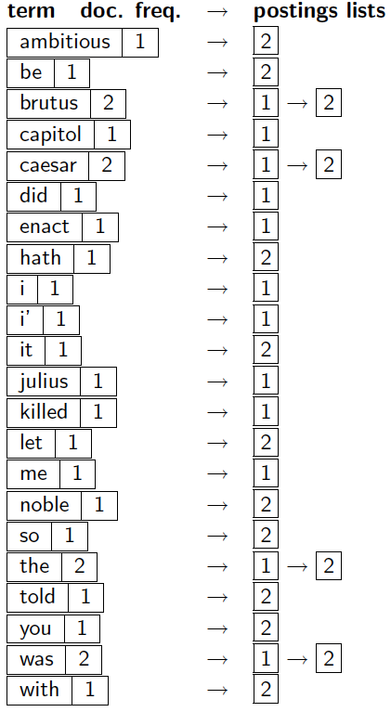
Indexer steps: Dictionary & Postings
Sec. 1.2
Multiple term entries in a single document are merged.
Split into Dictionary and Postings
Doc. frequency information is added.
Why frequency?
Will discuss later.

Slide 24
Where do we pay in storage?
Sec. 1.2
Lists of docIDs
Terms and counts
IR system implementation
How do we index efficiently?
How much storage do we need?
Pointers

Slide 25
Query processing
Sec. 1.3
How do we process a query?
Later - what kinds of queries can we process?

Slide 26
Query processing: AND
Sec. 1.3
Consider processing the query:
Brutus AND Caesar
Locate Brutus in the Dictionary;
Retrieve its postings.
Locate Caesar in the Dictionary;
Retrieve its postings.
“Merge” the two postings (intersect the document sets):
2
4
8
16
32
64
128
Brutus
1
2
3
5
8
13
21
34
Caesar

Slide 27
The merge
Sec. 1.3
Walk through the two postings simultaneously, in time linear in the total number of postings entries
2
4
8
16
32
64
128
Brutus
1
2
3
5
8
13
21
34
Caesar
If the list lengths are x and y, the merge takes O(x+y)
operations.
Crucial: postings sorted by docID.

Slide 28
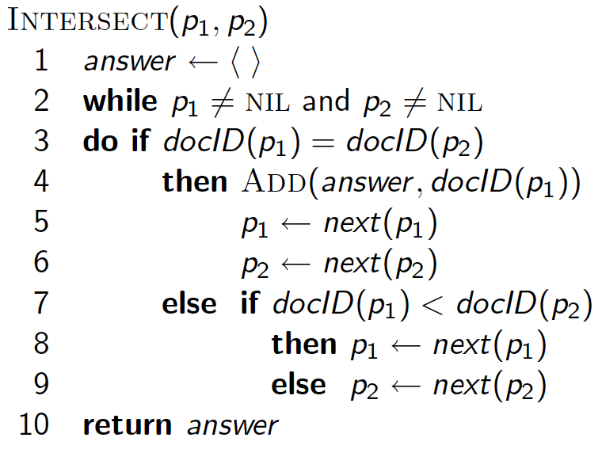
Intersecting two postings lists (a “merge” algorithm)

Slide 29
Boolean queries: More general merges
Sec. 1.3
Exercise: Adapt the merge for the queries:
Brutus AND NOT Caesar
Brutus OR NOT Caesar
Can we still run through the merge in time O(x+y)? What can we achieve?

Slide 30
Merging
Sec. 1.3
What about an arbitrary Boolean formula?
(Brutus OR Caesar) AND NOT
(Antony OR Cleopatra)
Can we always merge in “linear” time?
Linear in what?
Can we do better?

Slide 31
Query optimization
Sec. 1.3
What is the best order for query processing?
Consider a query that is an AND of n terms.
For each of the n terms, get its postings, then AND them together.
Brutus
2
4
8
16
32
64
128
Caesar
1
2
3
5
8
16
21
34
Calpurnia
13
16
Query: Brutus AND Calpurnia AND Caesar
31

Slide 32
Query optimization example
Sec. 1.3
Process in order of increasing freq:
start with smallest set, then keep cutting further.
This is why we kept
document freq. in dictionary
Brutus
2
4
8
16
32
64
128
Caesar
1
2
3
5
8
16
21
34
Calpurnia
13
16
Execute the query as (Calpurnia AND Brutus) AND Caesar.

Slide 33
More general optimization
Sec. 1.3
e.g., (madding OR crowd) AND (ignoble OR strife)
Get doc. freq.’s for all terms.
Estimate the size of each OR by the sum of its doc. freq.’s (conservative).
Process in increasing order of OR sizes.

Slide 34
Quick review
Sec. 1.2
Lists of docIDs
Terms and counts
Pointers

Slide 35
Exercise
Recommend a query processing order for
Which two terms should we process first?
(tangerine OR trees) AND
(marmalade OR skies) AND
(kaleidoscope OR eyes)

Slide 36
More optimization: skip pointers
Sec. 2.3
Walk through the two postings simultaneously, in time linear in the total number of postings entries
2
4
8
41
48
64
128
Brutus
2
8
1
2
3
8
11
17
21
31
Caesar
If the list lengths are m and n, the merge takes O(m+n)
operations.
Can we do better?
Yes (if the index isn’t changing too fast).

Slide 37
Augment postings with skip pointers (at indexing time)
Sec. 2.3
41
128
2
4
8
41
48
64
128
11
31
1
2
3
8
11
17
21
31
Why?
To skip postings that will not figure in the search results.
How?
Where do we place skip pointers?

Slide 38
Query processing with skip pointers
Sec. 2.3
41
128
2
4
8
41
48
64
128
11
31
1
2
3
8
11
17
21
31
Suppose we’ve stepped through the lists until we process 8 on each list. We match it and advance.
We then have 41 and 11 on the lower. 11 is smaller.
But the skip successor of 11 on the lower list is 31, so
we can skip ahead past the intervening postings.

Slide 39
Where do we place skips?
Sec. 2.3
Tradeoff:
More skips → shorter skip spans ⇒ more likely to skip. But lots of comparisons to skip pointers.
Fewer skips → few pointer comparison, but then long skip spans ⇒ few successful skips.

Slide 40
Placing skips
Sec. 2.3
Simple heuristic: for postings of length L, use √L evenly-spaced skip pointers [Moffat and Zobel 1996]
This ignores the distribution of query terms.
Easy if the index is relatively static; harder if L keeps changing because of updates.
This definitely used to help; with modern hardware it may not unless you’re memory-based [Bahle et al. 2002]
The I/O cost of loading a bigger postings list can outweigh the gains from quicker in memory merging!

Slide 41
Phrase queries
Sec. 2.4
We want to be able to answer queries such as “stanford university” – as a phrase
Thus the sentence “I went to university at Stanford” is not a match.
The concept of phrase queries has proven easily understood by users; one of the few “advanced search” ideas that works
Many more queries are implicit phrase queries
For this, it no longer suffices to store only
<term : docs> entries

Slide 42
Naïve method: Biword indexes
Sec. 2.4.1
Index every consecutive pair of terms in the text as a phrase
For example the text “Friends, Romans, Countrymen” would generate the biwords
friends romans
romans countrymen
Each of these biwords is now a dictionary term
Two-word phrase query-processing is now immediate.

Slide 43
Longer phrase queries
Sec. 2.4.1
Longer phrases can be processed by breaking them down
stanford university palo alto can be broken into the Boolean query on biwords:
stanford university AND university palo AND palo alto
Without the docs, we cannot verify that the docs matching the above Boolean query do contain the phrase.
Can have false positives!

Slide 44
Issues for biword indexes
Sec. 2.4.1
False positives, as noted before
Index blowup due to bigger dictionary
Infeasible for more than biwords, big even for them
Biword indexes are not the standard solution (for all biwords) but can be part of a compound strategy

Slide 45
Solution 2: Positional indexes
Sec. 2.4.2
In the postings, store, for each term the position(s) in which tokens of it appear:
<term, number of docs containing term;
doc1: position1, position2 … ;
doc2: position1, position2 … ;
etc.>

Slide 46
Positional index example
Sec. 2.4.2
<be: 993427;
1: 7, 18, 33, 72, 86, 231;
2: 3, 149;
4: 17, 191, 291, 430, 434;
5: 363, 367, …>
Which of docs 1,2,4,5
could contain “to be
or not to be”?
For phrase queries, we use a merge algorithm recursively at the document level
But we now need to deal with more than just equality

Slide 47
Processing a phrase query
Sec. 2.4.2
Extract inverted index entries for each distinct term: to, be, or, not.
Merge their doc:position lists to enumerate all positions with “to be or not to be”.
to:
2:1,17,74,222,551; 4:8,16,190,429,433; 7:13,23,191; ...
be:
1:17,19; 4:17,191,291,430,434; 5:14,19,101; ...
Same general method for proximity searches

Slide 48
Positional index size
Sec. 2.4.2
A positional index expands postings storage substantially
Even though indices can be compressed
Nevertheless, a positional index is now standardly used because of the power and usefulness of phrase and proximity queries … whether used explicitly or implicitly in a ranking retrieval system.

Slide 49
Positional index size
Sec. 2.4.2
Need an entry for each occurrence, not just once per document
Index size depends on average document size
Average web page has <1000 terms
Novels … easily 100,000 terms
Consider a term with frequency 0.1%
Document size
Postings
Positional postings
1000
1
1
100,000
1
100

Slide 50
Rules of thumb
Sec. 2.4.2
A positional index is 2–4 as large as a non-positional index
Positional index size 35–50% of volume of original text
At this point you can start thinking about compressing the index itself

Slide 51
Proximity queries: example
Sec. 1.4
Largest commercial (paying subscribers) legal search service (started 1975; ranking added 1992; new federated search added 2010)
Tens of terabytes of data; ~700,000 users
Majority of users still use boolean queries
Example query:
What is the statute of limitations in cases involving the federal tort claims act?
LIMIT! /3 STATUTE ACTION /S FEDERAL /2 TORT /3 CLAIM
/3 = within 3 words, /S = in same sentence

Slide 52
Example: WestLaw
Sec. 1.4
Another example query:
Requirements for disabled people to be able to access a workplace
disabl! /p access! /s work-site work-place (employment /3 place
Note that SPACE is disjunction, not conjunction!
Long, precise queries; proximity operators; incrementally developed; not like web search
Many professional searchers still like Boolean search
You know exactly what you are getting
But that doesn’t mean it actually works better….

Slide 53
Proximity queries
Sec. 2.4.2
LIMIT! /3 STATUTE /3 FEDERAL /2 TORT
Again, here, /k means “within k words of”.
Clearly, positional indexes can be used for such queries; biword indexes cannot.
Adapt the linear merge of postings to handle proximity queries.
Can you make it work for any value of k?
This is a little tricky to do correctly and efficiently

Slide 54
Combination schemes
Sec. 2.4.3
These two approaches can be combined
For particular phrases (“Michael Jackson”, “Britney Spears”) it is inefficient to keep on merging positional postings lists
Williams et al. (2004) evaluate a more sophisticated mixed indexing scheme
A typical web query mixture was executed in ¼ of the time of using just a positional index
It required 26% more space than having a positional index alone

